Slide 1
Chapter 3: System-Level Design Issues: Rules and Tools
Reuse Methodology Manual for System-On-Chip Designs
Notes:
This is the light cover slide option.

Slide 2
Chapter content
The Standard Model for Design Reuse
Design for Timing Closure: Logic Design Issues
Design for Timing Closure: Physical Design Issues
Design for Verification: Verification Strategy
System Interconnect and On-Chip Buses
Design for Bring-Up and Debug: On-Chip Debug Structures
Design for Low Power
Design for Test: Manufacturing Test Strategies
Prerequisites for Reuse

Slide 3
Chapter Introduction
In this chapter, we discuss the design guidelines for producing well-designed IP, as well as how to integrate well-designed IP into an SoC design.
These guidelines are largely driven by the needs of the IP integrator and chip designer.

Slide 4
1. The Standard Model
“A well-designed IP is the key to successful SoC design”
For reuse guidelines, we have mainly 3 premises underlie them:
Discipline: Restricting the design domain to practices that consistently produce scalable, supportable and easy-to-integrate designs.
Simplicity: The simpler the design, the easier to analyze, simulate, verify, reach timing closure.
Locality: Decoupling the block from its surrounding and design and analyze it on its own has a huge pay off in reducing the design time and improving the quality of a design. And that’s achieved by:
Buffering inputs and outputs
Designing “good” interfaces with neighboring blocks

Slide 5
1. The Standard Model
Soft IP vs. Hard IP
Soft IP: is on that is delivered to the integrator as synthesizable RTL
Hard IP: is one that is delivered to the integrator as a GDSII file. (fully designed, placed and routed by the supplier
There used to be a debate of what blocks should be synthesized from RTL and which should be designed at the transistor level.
With proper reuse-based SoC designs the role of hard and soft IP has become quite clear.
Memory cells that are tiled together to create memory arrays, analog blocks such as ADC, DAC and PLL are designed ,at least partially, at transistor level. Also, some microprocessors that efficiency is a critical aspect of it (beside having huge teams that work on it).
All other digital designs start out as Soft IP and then gets “hardened” by going the whole ASIC flow until generating the GDSII file which turns to be Hard IP.
The advantage of Pre-Hardened blocks is that they go the physical design once and can be used many times.
The advantage of synthesis-based design over full-custom design is that it’s more simpler, much faster and less costlier implementation of the design. On the other hand, full custom provides higher efficiency (power, timing, area).

Slide 6
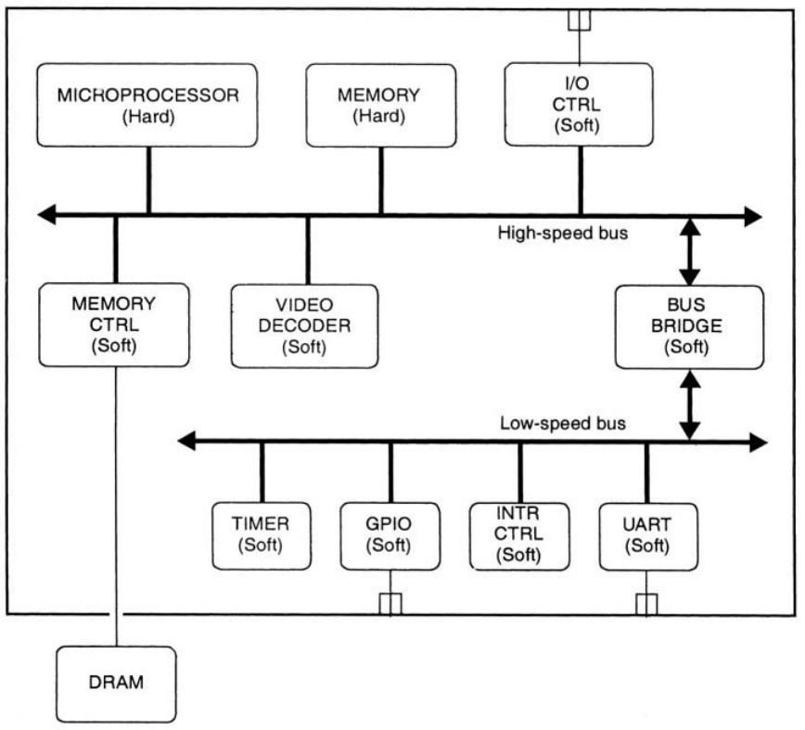
1. The Standard Model
Soft IP vs. Hard IP
Source of IP for a canonical design

Slide 7
1. The Standard Model
The Role of Full-Custom Design in Reuse
Full-Custom design is used when synthesis is not possible (or will cause a huge degrade in performance)
Such as: memories, analog blocks, physical layer interfaces of high-speed communication protocols.
For everything else, synthesis-based standard cell design have the higher hand in terms of economics (cost and time to market) where the full-custom doesn’t give competitive advantage in the marketplace.
There’s a comparison of a design implemented twice, full-custom and synthesis-based, and here’re the results:
Same max clock frequency.
Less power with a few percent than the full-custom.
Area was 7% higher due to an arithmetic operator. By replacing it with a full-custom one, the area was the same for the entire full-custom.
We can conclude that the full-custom design is used only for small portion of the design, mainly Datapath blocks in processors, where it’s expected that full-custom will be avoided completely for other applications.

Slide 8
2. Design for Timing Closure: Logic Design Issues
2.1 Interfaces and Timing Closure
In deep submicron technologies, the wire delay due to wire load capacitance can be much higher than the intrinsic delay of the CMOS gate. Wire load models are used to get an estimate of those delays. But for large blocks, the estimation becomes more variant than the actual delay.
We can decrease the delays by increasing the drive strength of the cells or inserting buffers along the wire to decrease the rise and fall times as well as the delays.
The problem here is that the designer doesn’t know which wire will cause the delay and thus needs buffering or change in the architecture (pipelining for instance) so we will have higher time in process iteration.

Slide 9
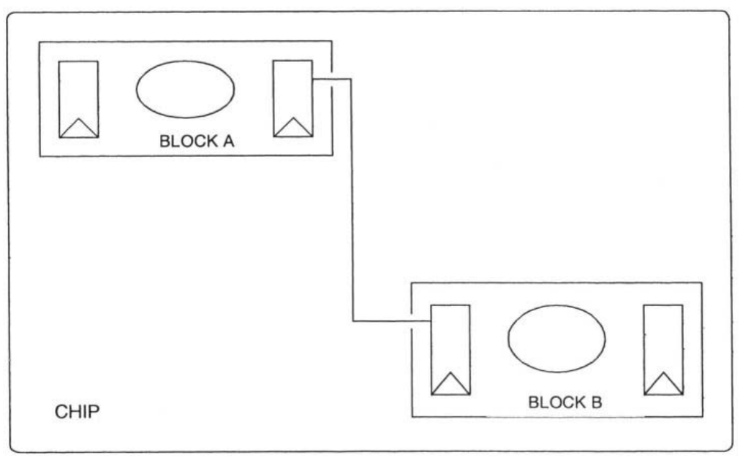
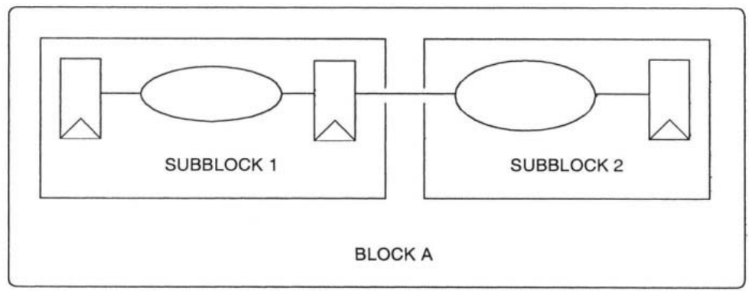
2. Design for Timing Closure: Logic Design Issues
Macro Interface
we need to register both inputs and outputs to achieve locality of the design. That will cause, any timing violations can be solved in the top modules. Thus, designing multiple blocks in concurrently and independently.
This is called “Defensive timing design”.
Subblock Interface
In subblock interfacing, it’s sufficient to register only the outputs. Since the designer has the timing information needed to develop good timing budgets.
Also, as the subblocks inside a single block are relatively close to each other, it’s unlikely that the wires between them will cause any timing violations.
Registering inputs and outputs of major blocks
Source: Reuse Methodology Manual
Registering outputs of subblocks
Source: Reuse Methodology Manual

Slide 10
2. Design for Timing Closure: Logic Design Issues
2.2 Synchronous vs. Asynchronous Design Style
Rule – The system should be synchronous and register based. Avoid latch-based designs as possible.
Latch-based designs give some flexibility in timing which leads to the concept…
Time Borrowing: is the technique in which a longer path takes to borrow the time from the next path of subsequent logic.
For flip-flops, since we are sampling at the active edge, we may have a long combinational delay that will cause metastability for the next flip-flop or we may have a short combinational delay that will cause waste of time as we are restricted with the sampling time of the flip-flop.
So, we either reduce the clock frequency or we use high-driving cells that will consume more power.
For latches, if the combinational delay is long, it may still go through the latch since it’s in the transparent mode. And if the combinational delay is short, we don’t have to wait for the whole clock cycle to pass to get to the next combinational path or register since the latch is still in the transparent mode.

Slide 11
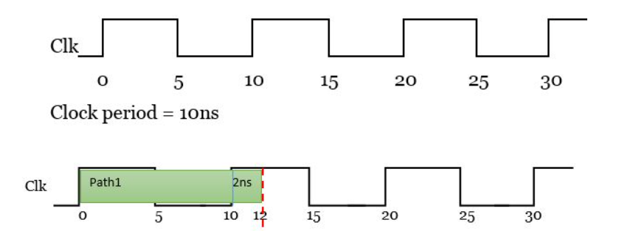
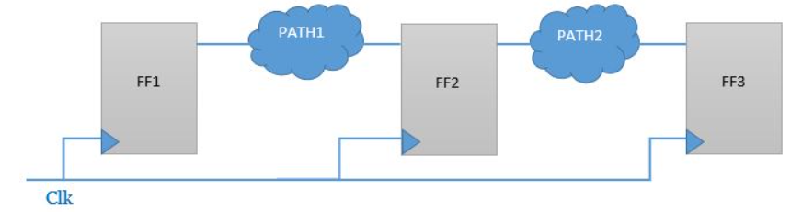
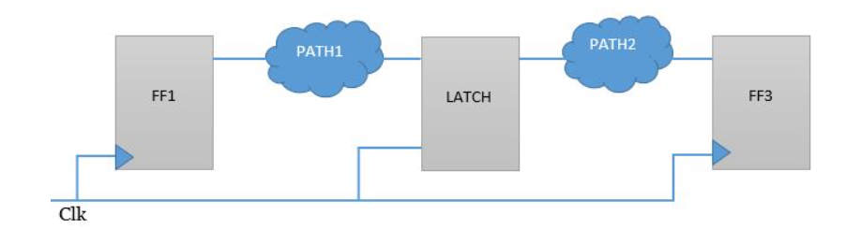
2. Design for Timing Closure: Logic Design Issues
2.2 Synchronous vs. Asynchronous Design Style
The problem is that in latch-based systems timing analysis of each latch of the design is difficult. Over a large design, timing analysis becomes impossible. Only the original designer knows the full intent of the design. Thus, latch-based design is inherently not reusable.

Slide 12
2. Design for Timing Closure: Logic Design Issues
2.3 Clocking
Most of the system nowadays require multiple clock domains. Either due to the different data rate of the different blocks or the clock gating of some modules. Thus, for any signal crossing multiple domains, there’s an opportunity for metastability and corrupted data. Therefore, there’re some rules and guidelines we need to stick to…
The system clock generation and control logic should be separate from all functional blocks of the system.
The number of clock domains and clock frequencies must be documented.
Required clock frequencies
External timing requirements (setup/hold and output timing) needed to interface to the rest of the system.
Skew requirements between different, but related, clock domains. (generated from each other or from the same source)
Use the smallest possible number of clock domains. If two asynchronous clock domains interact, they should meet in a single module, which should be as small as possible. Ideally, this module should consist solely of the flops required to transfer the data from one clock domain to the other.
If a Phase-Locked Loop (PLL) is used for on-chip clock generation, then some means of disabling or bypassing the PLL should be provided. For the sake of testing and debugging like DFT.
For hard blocks, which often have large insertion delay, they should have their own clock net that is used to compensate the effect of this insertion delay.

Slide 13
2. Design for Timing Closure: Logic Design Issues
2.4 Reset
Rule – The basic reset strategy for the chip must be documented. It is particularly important to address the following issues:
Is it synchronous or asynchronous?
Is there an internal or external power-on reset?
Is there more than one reset (hard vs. soft reset)?
Is each macro individually resettable for debug purposes?
Note – whether reset is synchronous or asynchronous, the de-assertion of the signal must be synchronous to ensure all flops exit the reset state on the same clock and to avoid removal violation.
Asynchronous Reset is, by far, the most common type of reset in the reusable design.
 | Asynchronous Reset | Synchronous Reset
Adv. | Doesn’t need free-running clock. Uses separate inputs to the flop, so it doesn’t affect flop timing. | Easy to synthesis as it may considered an input to the register.
DisAdv. | Hard to implement since it’s like clock needs a special network. Make the static timing analysis and cycle-based sim. more difficult. | Requires free-running clock, especially at the power up, for reset to occur.

Slide 14
2. Design for Timing Closure: Logic Design Issues
2.5 Timing Exceptions and Multicycle Paths
Asynchronous signals and other timing exceptions should be avoided; they make chip-level integration significantly more difficult.
If there will be any timing exceptions, they need to be fully identified, so that the synthesis tool exert much time ensuring this path meets the timing requirements (and sometimes they even can’t).
The problem is that the identification of the timing exception is a manual task that is prone to error so, it’s not recommended.

Slide 15
3. Design for Timing Closure: Physical Design Issues
After synthesis and meeting timing requirements, timing closure becomes a physical design issue.
So, we need to finish the timing closure rapidly by planning the physical design early (place and route).
3.1 Floorplanning
Rule – Floorplanning must begin early in the design process as the size of the chip is critical in determining the timing, performance and cost goals. Some floorplan should be developed as part of the initial functional specification for the SoC design.
That will be critical in determining the functional interfaces between macros and clock distribution.
RTL Floorplanning: which uses pre-synthesis RTL to generate a floorplan.
it’s useful to define a physical partitioning to be able to define time budgeting.
The partitioning strategy includes the following:
Define the logical hierarchies as soon as possible.
Define the physical hierarchies based on physical relationships.
Partition the constraints from a set of global constraints to several set of local constraints.
Partition scan chips and define I/O pins for them in DFT.

Slide 16
3. Design for Timing Closure: Physical Design Issues
3.2 Synthesis Strategy and Time Budgets
Rule – Overall design goals for timing, area, and power should be documented before macros are designed or selected. In particular, the overall chip synthesis methodology needs to be planned very early in the chip design process.
Each macro should have its own synthesis script that ensures that the internal timing of the macro can be met in the target technology.
Chip-level synthesis then consists solely of connecting the macros and resizing output drive buffers to meet actual wire load and fanout. Hence, the macro will be internals (don’t touched) and output drivers that undergo incremental compile.
3.3 Hard Macros
Rule – A strategy for floorplanning, placing, and routing a combination of hard and synthesized soft macros must be developed before hard macros are selected or designed for the chip. To prevent any blockage in the placement or the routing of the entire chip.

Slide 17
3. Design for Timing Closure: Physical Design Issues
3.4 Clock Distribution
Rule – The design team must decide on the basic clock distribution architecture for the chip early in the design process. The size of the chip, the target clock frequency, and the target library are all critical in determining the clock distribution architecture.

Slide 18
4. Design for Verification: Verification Strategy
The best strategy for verification is Bottom-Up by verifying each macro on its own as thoroughly as possible before integrated into the chip.
Rule - The system-level verification strategy must be developed and documented before macro selection or design begins.
Rule – The macro-level verification strategy must be developed and documented before the design of macros and major blocks for the chip begins. This strategy should be based on bottom-up verification.
The verification strategy also determines the kinds of testbenches required for system-or chip-level verification. These testbenches must accurately reflect the environment in which the final chip will work.

Slide 19
5. System Interconnect and On-Chip Buses
The standardization of buses has a clear purpose to reduce the design time and effort and the ability of reuse. But we also need to be careful of some issue that might be facing us during the reuse of a standard bus.
5.1 Basic Interface Issue
There’re several types of buses according to the application:
Private bus: that’s dedicated for a specific unit like a bus connecting a processor and a memory that are designed for a specific purpose. hence, the whole unit (processor, bus and memory) are reusable.
High-speed bus: provides a high-performance interface between the processor and the other high-bandwidth blocks in the design.
Low-speed bus: provides a separate bus for low-speed peripherals and peripherals rarely accessed by the processor. By reducing the clock speed, it is possible to reduce the power consumption of the bus and the peripherals on it significantly.

Slide 20
5. System Interconnect and On-Chip Buses
5.2 Tri-state vs. Mux Buses
Even though for board-level systems, it’s more popular to use tristate bus to reduce the number of wires in the design but on chip-level it’s always better to use mux-based buses to prevent any floating wires in the design that may cause reliability issue.
Rule – For these reasons, we consider multiplexer-based buses to be the only acceptable architecture for on-chip interconnect. Tristate buses should never be used on chip.
5.3 Synchronous Design of Buses
Besides meeting performance goals, on-chip buses must provide a well-defined environment for integrating reusable blocks from a variety of sources.
Rule – On-chip buses must use a single-clock-edge, flip-flop based architecture.
5.4 Summary
There’re other standard rules need to be mentioned:
Separate address and data buses.
Separate control bus that define the kind of transaction taking place.
Support for multiple masters.

Slide 21
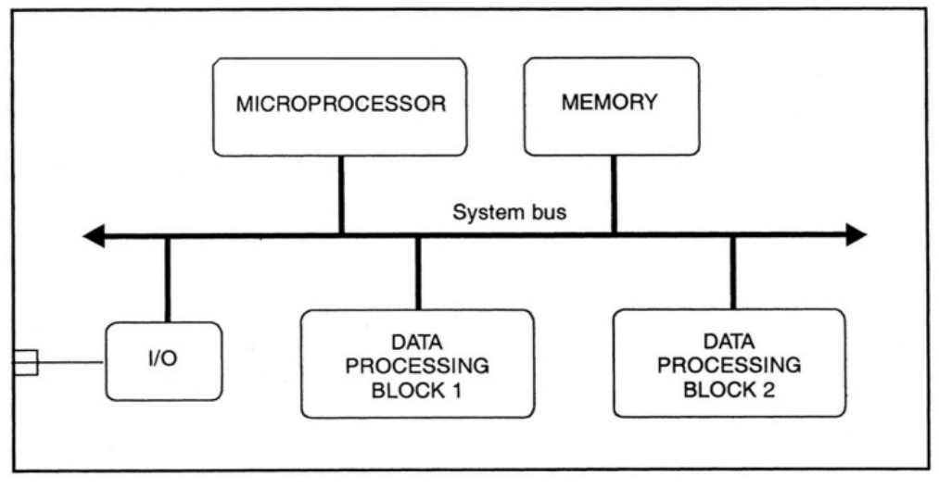
5. System Interconnect and On-Chip Buses
5.5 IP-to-IP interface
Guideline – The design team should choose an industry-standard bus for the chip design. Wherever possible, blocks should be connected to the bus and/or to the chip’s I/O pins. Point-to-point connections between blocks should be used only where absolutely necessary, and even then should use an industry-standard interface. Custom interfaces should be used only when no standard exists.
Guideline – In selecting macros for the chip design, either from internal sources or from third-party IP providers, the design team should only accept macros that interface directly to the selected bus.

Slide 22
6. Design for Bring-Up and Debug: On-Chip Debug Structures
Rule – The design team must develop a strategy for the bring-up and debug of the SoC design at the beginning of the design process.
The most effective debug strategies usually require specific features to be designed into the chip that greatly reduces the incremental cost of these features, in terms of design effort and schedule.
Guideline – Controllability and observability are the keys to an easy debug process.
Controllability is best achieved by design features in the macros themselves. The system should be designed so that each macro can be effectively turned off, turned on, or put into a debug mode where only its most basic functions are operational.
Observability is a major problem for SoC designs. We’d like to be able to put logic analyzer probes on internal nodes in the chip, and debug the chip the way we debug boards. For SoC designs, we can come close to this by adding additional circuitry on the chip to aid observability.

Slide 23
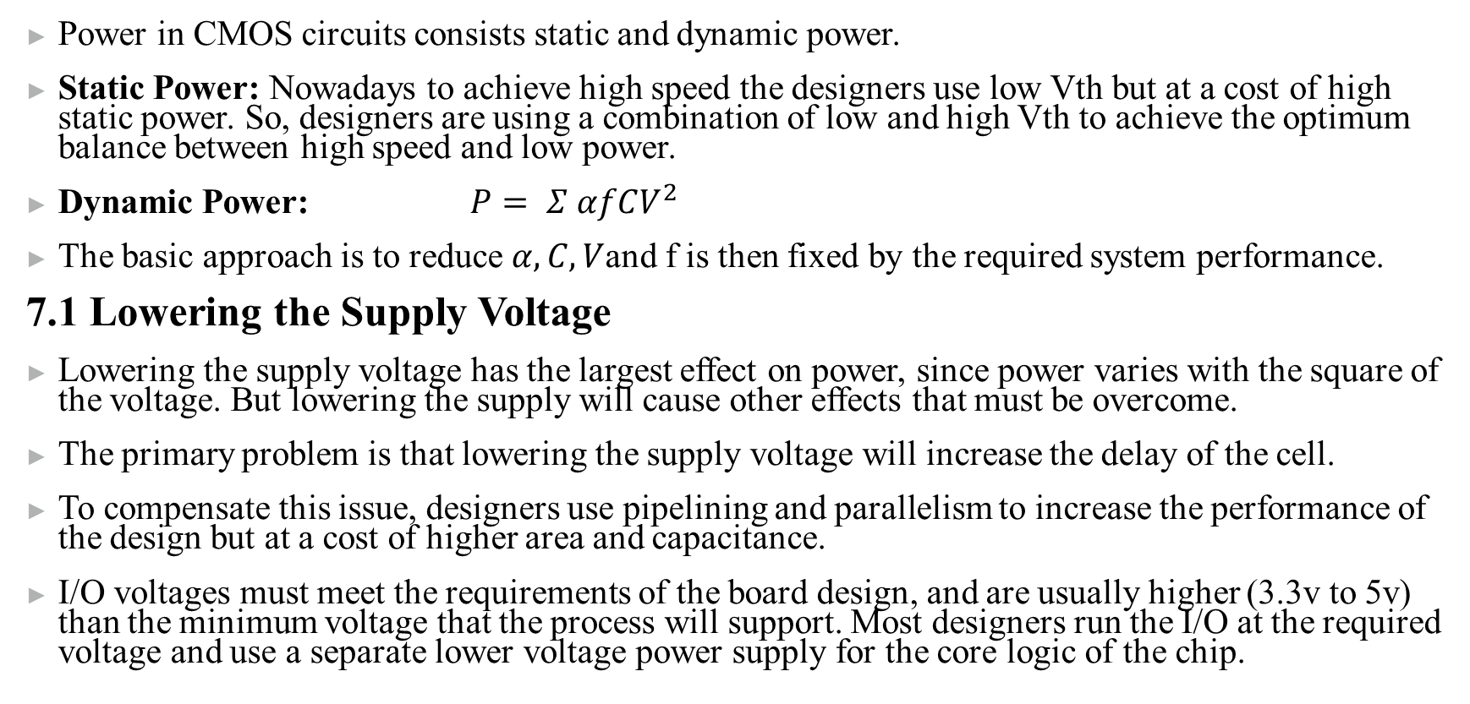
7. Design for Low Power
Power in CMOS circuits consists static and dynamic power.
Static Power: Nowadays to achieve high speed the designers use low Vth but at a cost of high static power. So, designers are using a combination of low and high Vth to achieve the optimum balance between high speed and low power.
Dynamic Power: $P= Σ αfCV^{2}$
The basic approach is to reduce $α,C,V$and f is then fixed by the required system performance.
7.1 Lowering the Supply Voltage
Lowering the supply voltage has the largest effect on power, since power varies with the square of the voltage. But lowering the supply will cause other effects that must be overcome.
The primary problem is that lowering the supply voltage will increase the delay of the cell.
To compensate this issue, designers use pipelining and parallelism to increase the performance of the design but at a cost of higher area and capacitance.
I/O voltages must meet the requirements of the board design, and are usually higher (3.3v to 5v) than the minimum voltage that the process will support. Most designers run the I/O at the required voltage and use a separate lower voltage power supply for the core logic of the chip.

Slide 24
7. Design for Low Power
7.2 Reducing the capacitance and switching activity
The standard cell library provider can use a variety of techniques to produce a low power library.
Once we have selected a good low-power library, we can use architectural and design techniques to reduce system power. In real chips, memory design, I/O cells, and the clocking network often dominate overall power. These areas deserve special attention when doing low-power design.
Reducing power in I/O requires minimizing the internal, short-circuit switching current (by selecting the right I/O cell from the library) and minimizing the capacitance of the external load.
Memory Architecture
Reducing power in on-chip memories involves bot circuitry and architectural techniques. Where most silicon providers have memory compilers that can produce a variety of memory designs that trade off area, power, and speed.
The memory architecture itself can reduce power significantly. Instead of using a single, deep memory, it may be possible to partition the memory into several blocks, selected by a decode of the upper or lower address bits. Only the block being accessed is powered up. This approach again produces redundant logic (in extra decode logic), so it reduces power at the expense of (slightly) increasing area.

Slide 25
7. Design for Low Power
7.2 Reducing the capacitance and switching activity
Clock Distribution
Shutting down clock distribution to part of the circuit by “clock gating” can significantly reduce chip power. Clock gating, however, can be very technology dependent; careful design is required to assure a portable, reusable design.
we can either gate the clock of a whole block or just a single flip-flop depending on the situation.
Gating the whole block will reduce the power significantly but needs to be carefully designed and detailed knowledge of the gate used. For this reason, the clock gating circuit itself tends to be technology dependent and not reusable.
In some cases, it may not be possible to gate the clock to an entire block, and the designer may want to gate the clock on a flop-by-flop basis. This case usually occurs on flops where we selectively hold data.
Guideline – It’s always recommended to prevent using clock gating for registers since it’s technology dependent and hence, not reusable and use enabling signal instead.

Slide 26
7. Design for Low Power
7.3 Sizing and Other Synthesis Techniques
Gate sizing can produce a significant power savings in many designs. This technique consists of reducing the drive strength of gates to the lowest level that meets the timing requirements for the design. Synthesis tools can do this automatically, without any requirement for changing the RTL code.
Some incremental improvement can be gained by restructuring logic to reduce the number of intermediate, spurious transitions in the logic. Again, synthesis tools can do this automatically.
7.4 Summary
There’s an analysis that have been made to estimate the power reduction due to the previous techniques.
A 21x reduction in power by lowering the voltage from 5v to l.lv. With changing the geometry to lower designed specifically for low power.
A 3-4x reduction from gate sizing, low-power I/O cells, and similar gate-level optimizations.
A 2-3x improvement by clock gating.
An 8x improvement in a memory-array using the multi-block technique described above.

Slide 27
8. Design for Test: Manufacturing Test Strategies
8.1 System-Level Test Issues
Rule – The system-level chip manufacturing test strategy must be documented.
Guideline – On-chip test structures are recommended for all blocks.
Guideline – Include an asynchronous set or reset function for all flip-flops. To set the chip to a known state which makes test programs easier to create.
8.2 Memory Test
Guideline – Some form of BIST (Built In Self Test) is recommended for RAMs, because this provides a rapid, easy-to-control test methodology. However, some BIST solutions are not sufficient to test data retention.

Slide 28
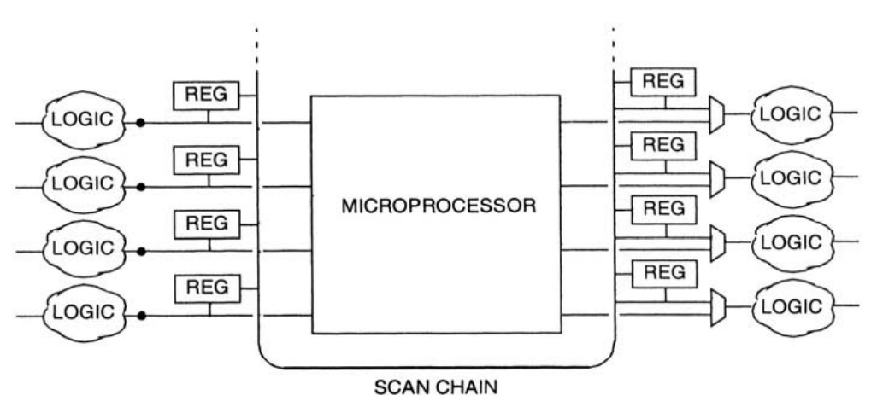
8. Design for Test: Manufacturing Test Strategies
8.3 Microprocessor Test
The key challenge in integrating the processor into the overall scan testing of the chip involves
dealing with the interface between the processor and the rest of the chip.
The shadow registers provide isolation between the processor scan chain and that of the rest of the chip, making scan test pattern generation two separate, local problems.

Slide 29
8. Design for Test: Manufacturing Test Strategies
8.4 Other Macros
Guideline – For most other blocks, the best choice is a full-scan technique. Full scan provides very high coverage for very little design effort.
8.5 Logic BIST
Logic BIST is a variation on the full-scan approach. Where full scan must have its scan chain integrated into the chip’s overall scan chain(s), logic BIST uses a Linear Feedback Shift Register (LFSR) to generate the test patterns locally.
Logic BIST has the advantage of keeping all pattern generation and checking within the macro. This provides some element of additional security against reverse engineering of the macro. It also reduces the requirements for scan memory in the tester and allows testing at higher clock rates than can be achieved on most testers.

Slide 30
9. Prerequisites for Reuse
We conclude this chapter with a discussion of the technical infrastructure that must be in place for the standard model of reuse to be successful.
9.1 Libraries
design teams must have access to high-quality standard cell libraries:
Full set of views (synthesis, physical and power views).
Need to be validated in hardware so that design teams can have a high degree of confidence in their timing and power characteristics.
The libraries should have a reasonably accurate, validated wire load models to enable useful pre-layout synthesis and timing analysis of designs.
These libraries need to be tested in the SoC flow before they can be considered completely validated.
These libraries should also include a set of memory compilers. These memory compilers should provide for some tradeoffs between power, area, and timing performance.
Libraries should also provide special cells for clock gating.
Certain analog block that are frequently used like PLLs, ADC and DAC.
Guideline – cell names should be unique to the library.

Slide 31
9. Prerequisites for Reuse
9.2 Physical Design Rules
One common problem in large designs is that several pieces of hard IP are integrated from different sources. If these blocks have been designed with different physical design rules, and verified using different DRC decks, then physical verification at the chip level can be a major problem.
There have to be a standard DRC and LVS rules be developed and validated that should be used by all the design teams, so that physical designs can be exchanged and integrated without undue effort.

